Slide 1
Faculty Promotions
Key Points & Available Supports
7th February 2024
Sarah Dunne
Promotions & Grading Specialist
HR Promotions & Grading
UCD People and Organisation Development

Slide 2
Faculty Promotions Committee

Slide 3
Faculty Promotions Committee
Name | College / Unit | Term
Professor Colin Scott | Registrar and Deputy President | Ex Officio
Professor Maria Brenner | Health and Agricultural Sciences | 2013-2026
Professor Eoin Casey | Engineering and Architecture | 2021-2024
Professor Mark Crowe | Health and Agricultural Sciences | 2021-2024
Professor Dympna Devine | Social Sciences and Law | 2021-2024
Professor Fiona Doohan | Science | 2022-2025
Professor Anne Keegan | Business | 2021-2024
Professor Gary McGuire | Science | 2020-2024
Professor Bettina Migge | Arts and Humanities | 2023-2026
Professor Karl Whelan | Social Sciences and Law | 2022-2025
With effect 1st September 2023 membership of the FPC is as above.
Membership is normally for a 3-year term which may be renewed, in exceptional circumstances, up to a further 3 years to ensure consistency and continuity.
Membership of the FPC is subject to review by the President and the Governing Authority.

Slide 4
Faculty Promotions Key Points
Application
Rolling application process
Principle of self reflection
Discuss with Head of School /other colleagues to proactively consider readiness
Process
Committee meets 9 times per annum
Applications can take approx. 11 - 12 months to process
Feedback – intended to be constructive, actionable and to inform next application
Resources & Support
Promotions & Grading Website
UCD Development Framework for Faculty
Online Faculty Promotions Infohub System User Guide
Faculty Development Workspace
Head of School and College Principal
Sample Applications
Faculty Career Mentoring
Candidate Workshops
[Unit Name]

Slide 5
Faculty Development Workspace

Slide 6
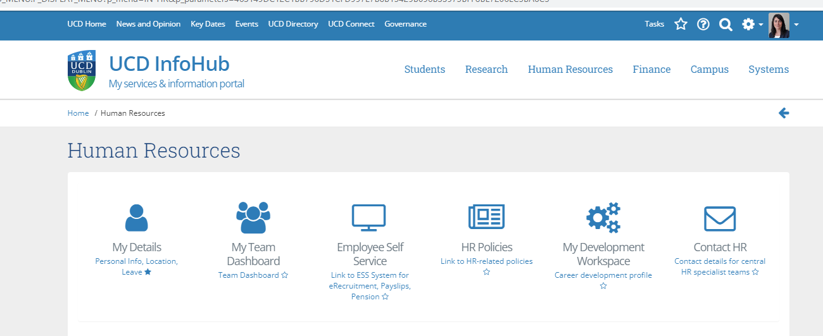
Faculty Development Workspace

Slide 7
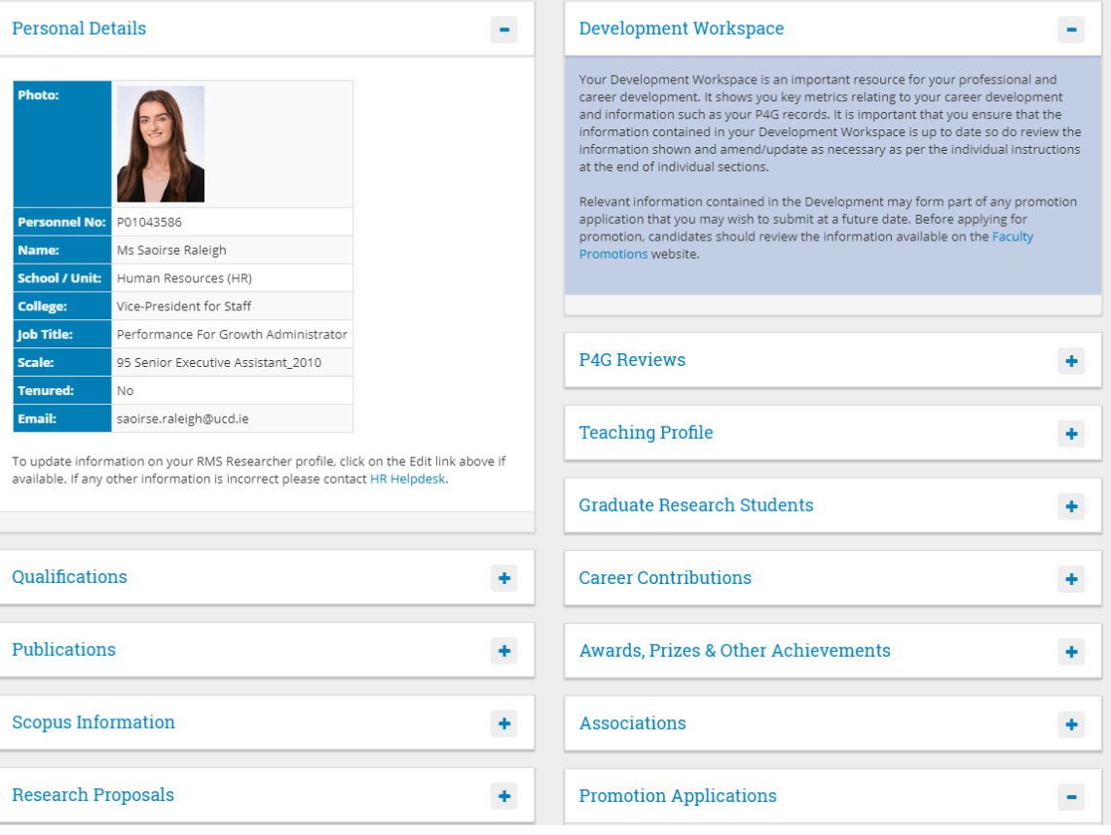

Slide 8
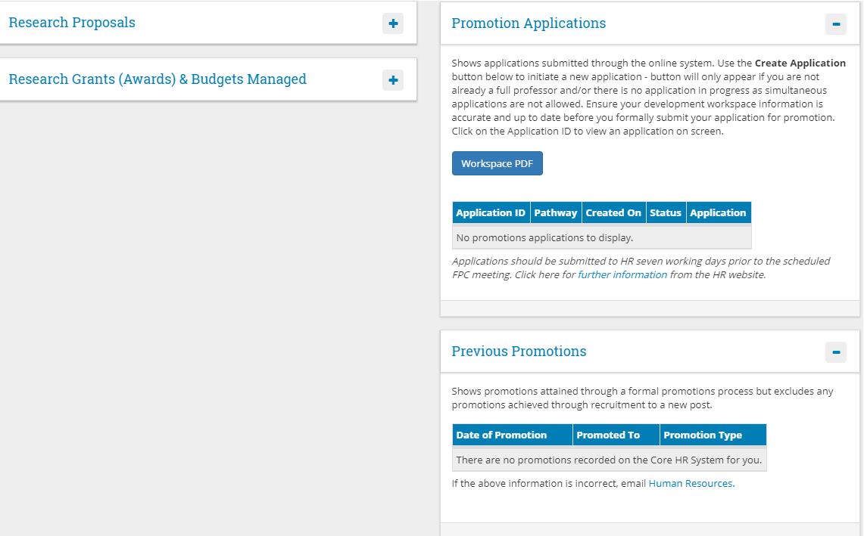

Slide 9
UCD Development Framework for
Faculty

Slide 10
Outline of Dimensions within the Framework
Categories | Dimensions
Research, Scholarship and Innovation | Qualifications
 | Publication and Profile
 | Research Funding
 | Research Supervision and Management
 | Research Culture
 | Innovation and Impact
Teaching and Learning | Facilitated Student Learning
 | Curriculum Design, Assessment and Development
 | Scholarship of Teaching and Learning
 | Enhancement of Practice: Personal and Professional Development
Leadership and Contribution | Administration and Leadership
 | Recruitment and Outreach
 | Building Community
 | Building Support
 | Professional / Clinical Service
 | Public and Professional Engagement

Slide 11
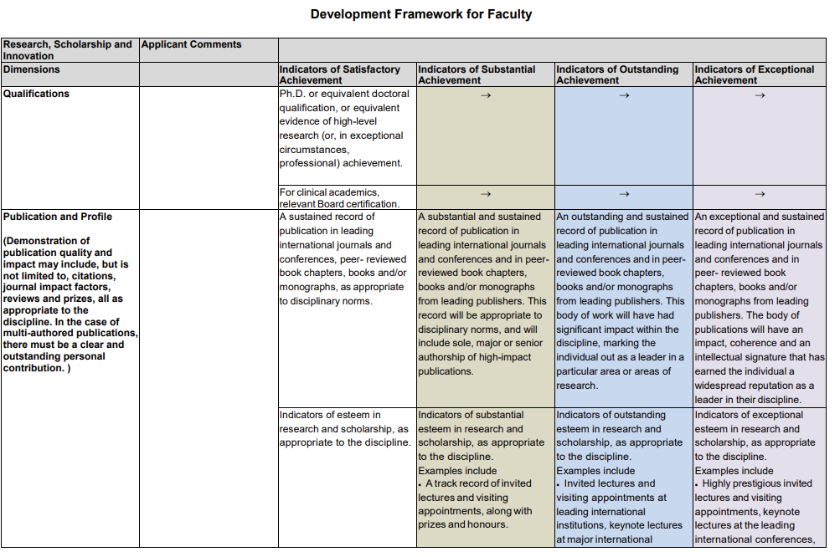
Development Framework for Faculty
Categories
Dimensions
Indicators of Achievement
Categories
Research, Scholarship and Innovation
Teaching and Learning
Leadership and Contribution

Slide 12
Faculty Promotions Workshops for Candidates

Slide 13
Faculty Promotions Workshops for Candidates:
Faculty Promotions Candidate workshops are held 3 times per year and normally
hosted by the Registrar as Chair of the Faculty Promotions Committee.
24th January 2024
5th June 2024
Ready to book now via the People Development Page

Slide 14
Sample Applications

Slide 15
Sample Applications – useful contacts
Following a recommendation as part of the Gender Equality Action Plan, sample applications are available from successful former candidates are available to candidates preparing for promotion.
Lists from consenting candidates are available via promotions@ucd.ie
They may choose to redact sensitive information that they do not wish to share as part of this process.
These lists are subject to change and based on ongoing consent.

Slide 16
Faculty Career Mentoring

Slide 17
Faculty Career Mentoring: Suite of supports for those considering a promotion application
Information regarding the mentoring available at UCD for faculty at various transition points
in their career, for example, preparing for promotion is available on the
People and Organisation Development website.
Please contact peopledevelopment@ucd.ie with any queries regarding mentoring.

Slide 18
Faculty Promotions in Numbers

Slide 19
Promotions in Numbers: Sept ’17 – Aug ‘22
Number of applications by College
 | A&H | B | E&A | H&AS | S | SS&L | Totals
Male | 19 | 7 | 29 | 35 | 45 | 33 | 145 | Numbers
Female | 30 | 10 | 10 | 42 | 22 | 44 | 181
Total | 49 | 18 | 39 | 77 | 67 | 77 | 326
Successful applications by College
 | A&H | B | E&A | H&AS | S | SS&L | Totals
Male | 12 | 1 | 15 | 27 | 30 | 27 | 102 | Numbers
Female | 22 | 7 | 7 | 32 | 20 | 30 | 128
Total | 34 | 8 | 22 | 59 | 50 | 57 | 230
Male % | 63% | 14% | 52% | 77% | 67% | 82% | 70% | % Success Rate
Female % | 73% | 70% | 70% | 76% | 91% | 68% | 71%
Total % | 69% | 44% | 56% | 77% | 75% | 74% | 71%
Notes:
Current success rate is 70% overall

Slide 20
We welcome your questions and comments.

